Slide 1
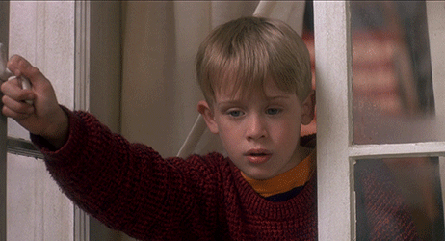

Slide 2
Where are you?
I’m in the kitchen.

Slide 3
Where is she?
She’s in the bathroom.

Slide 4
Where is Justin Bieber?
He’s in the yard.

Slide 5
Where is Pikachu?
It’s in the bedroom.

Slide 6
Where are we ?
We’re in the dining room.

Slide 7
Where are Simpsons?
They’re in the living room.

Slide 9
Q&A:
1. How many characters in this
story?
2. Where are they gathering?
3. What are they going to play?
4. What’s this game?
5. Who lost the game?

Slide 10
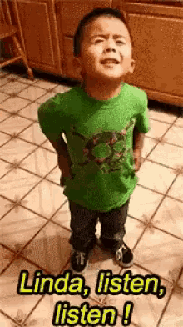

Slide 11
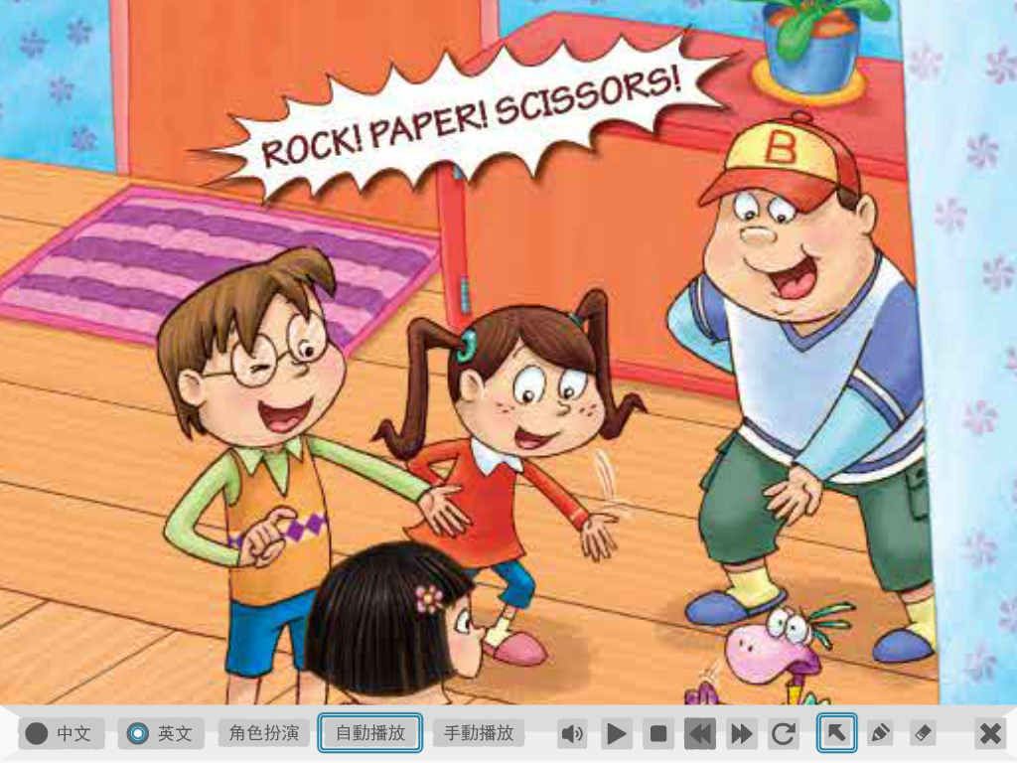
Paper! Scissors!
Stone!

Slide 12
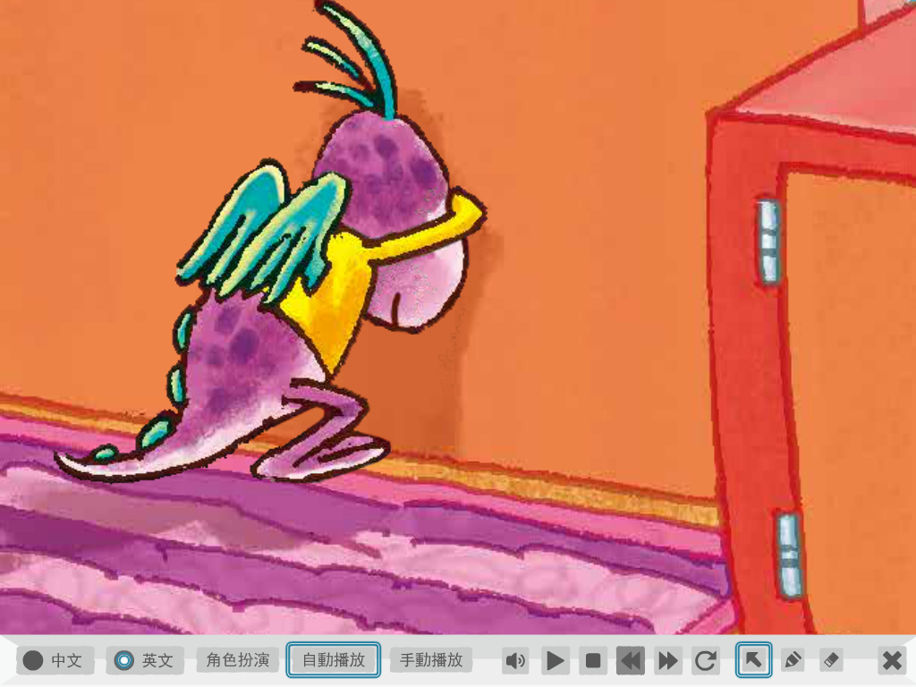
Dino is counting.

Slide 13
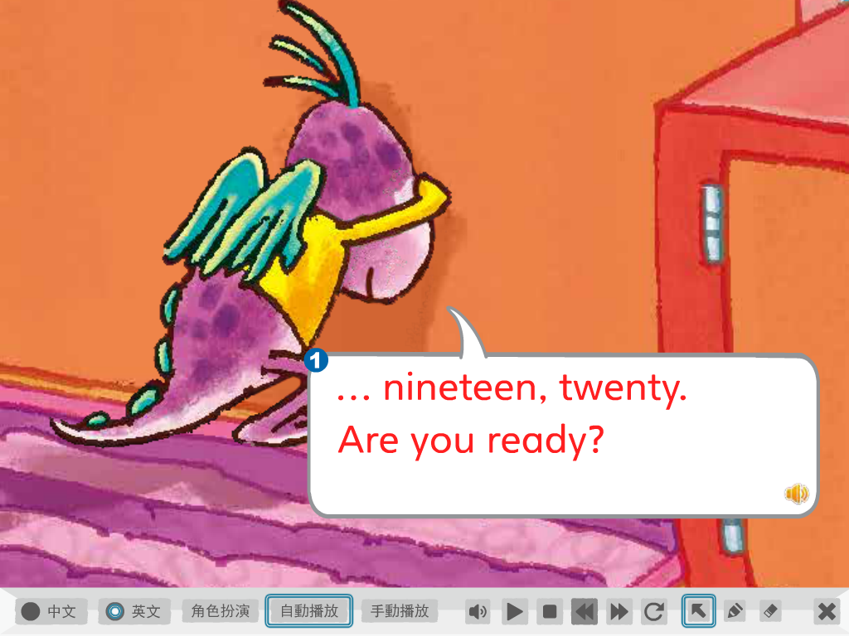

Slide 14
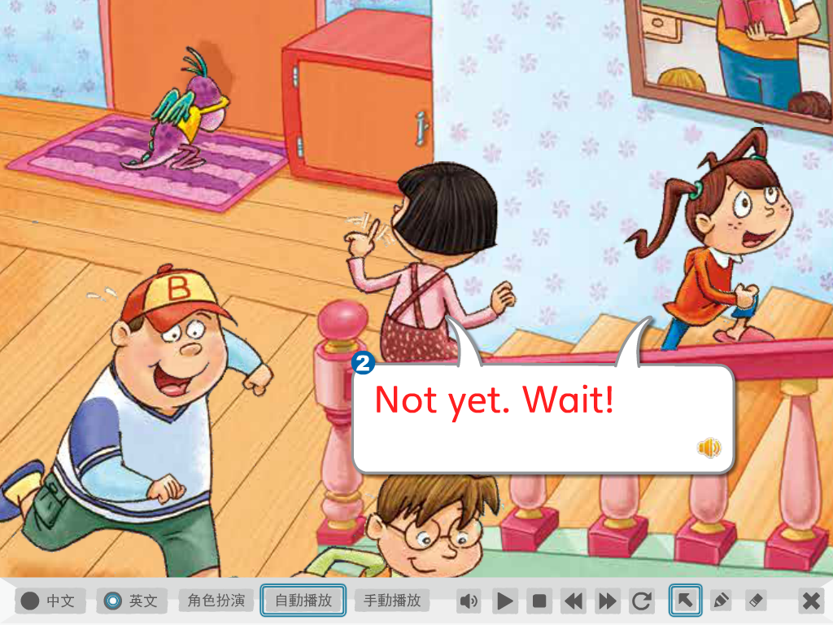
還沒

Slide 15
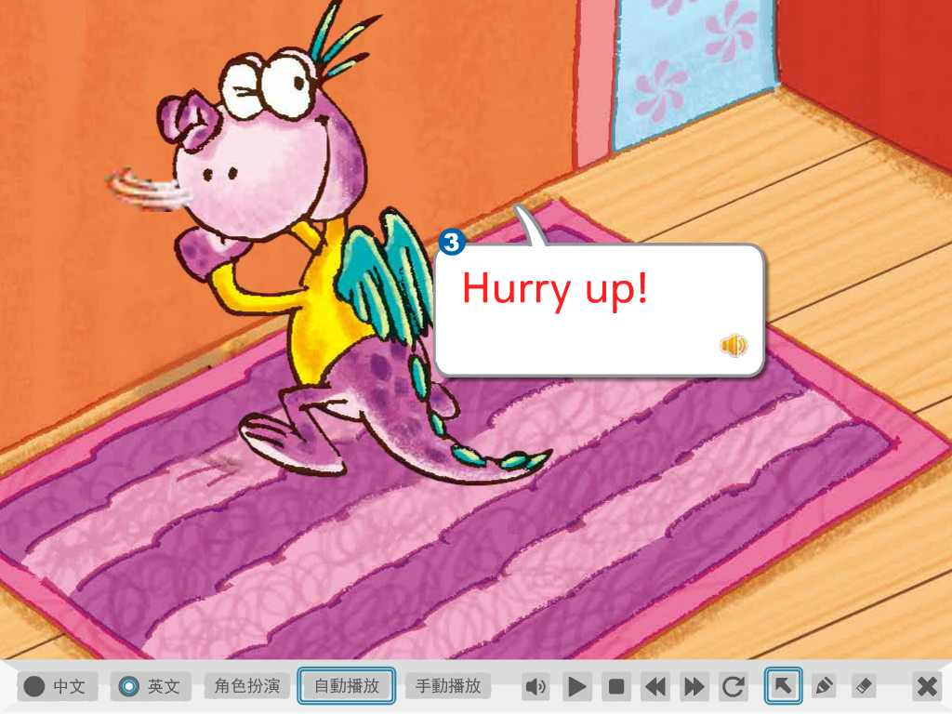
Be quick!

Slide 16
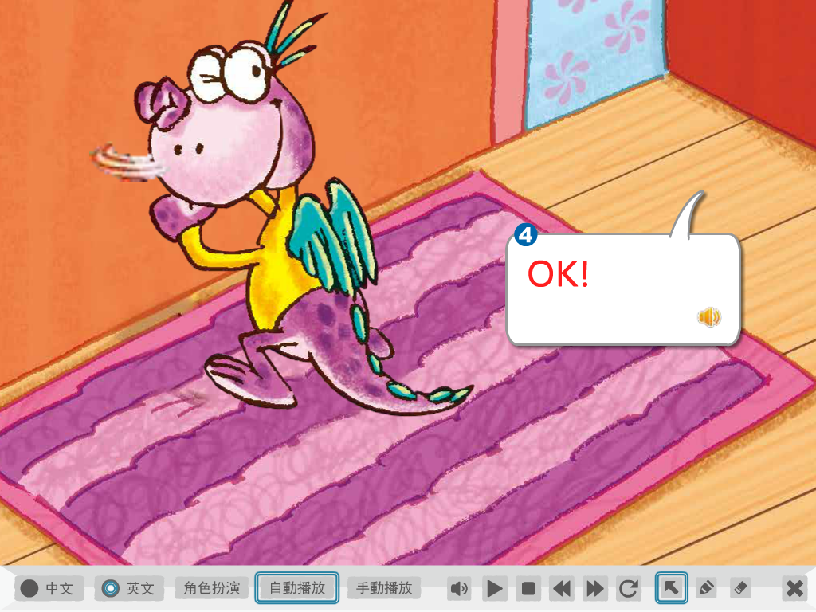
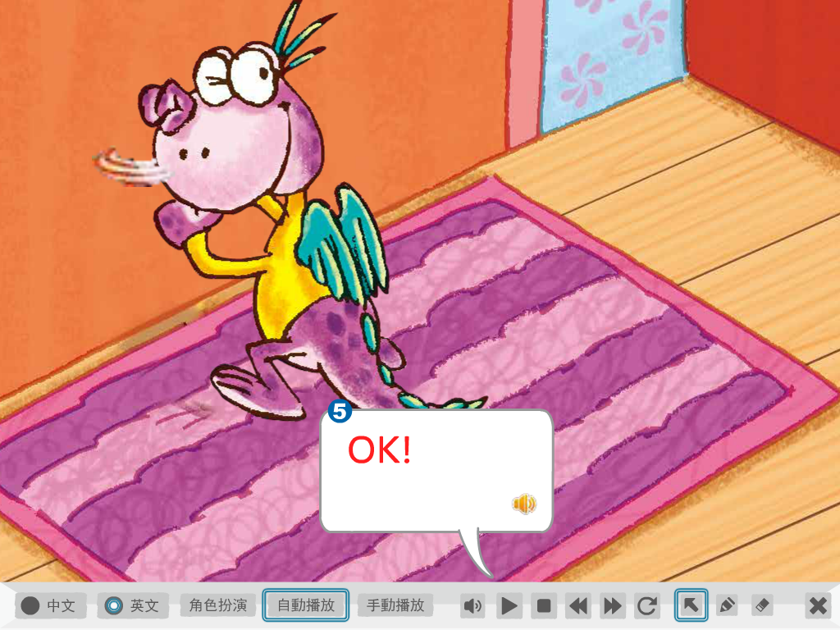

Slide 17
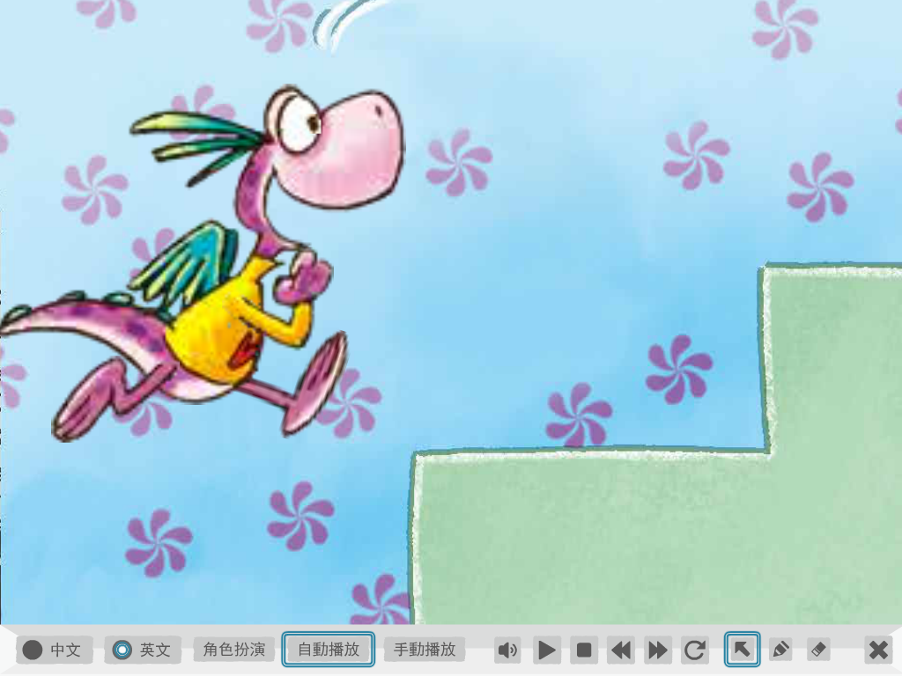
Dino is climbing up the stairs.

Slide 18
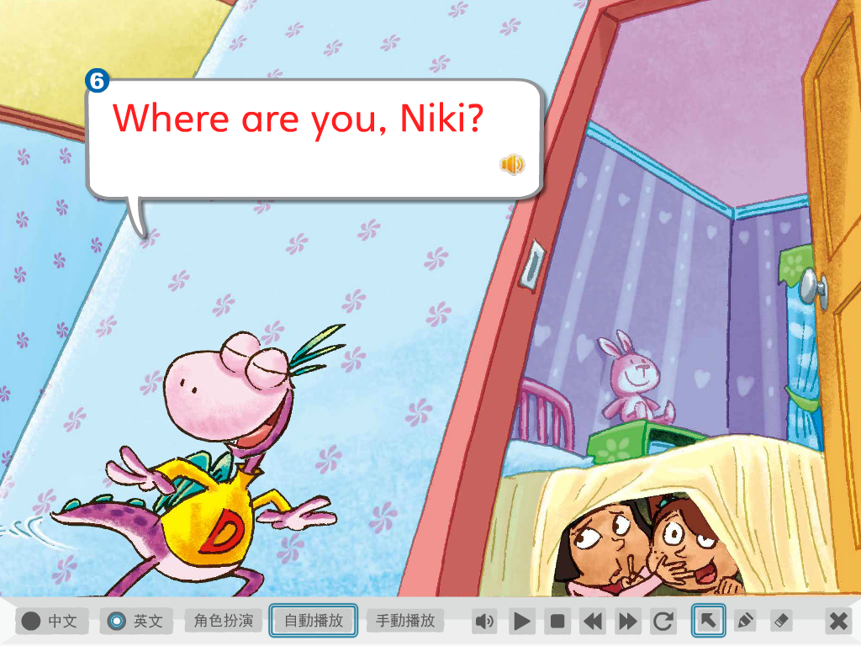

Slide 19
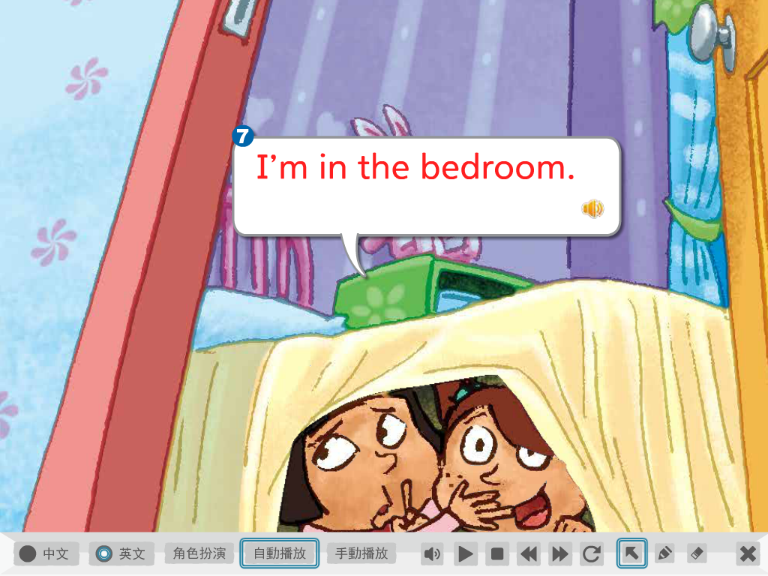

Slide 20
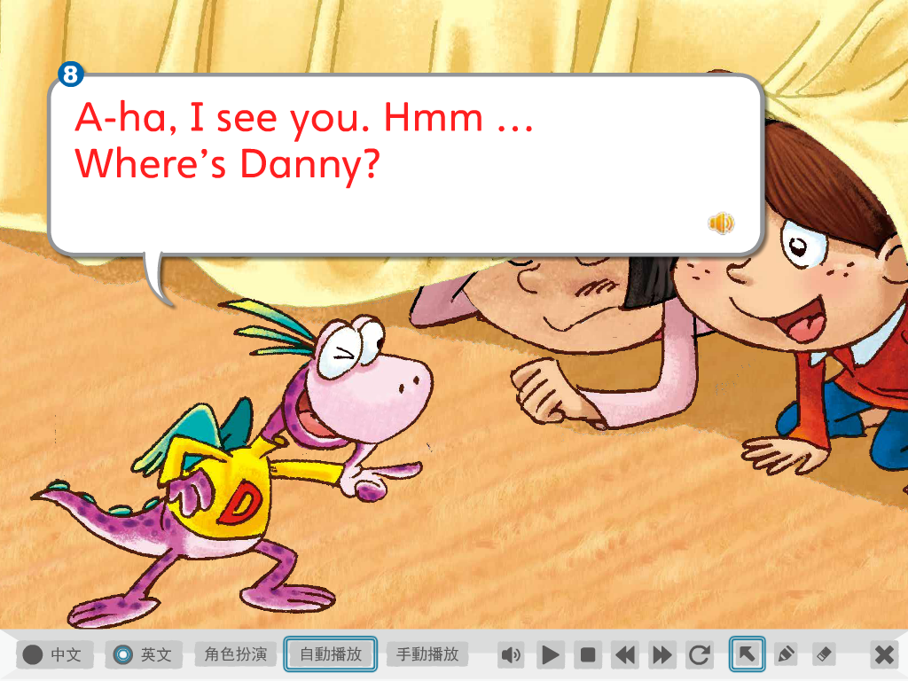
嗯…

Slide 22
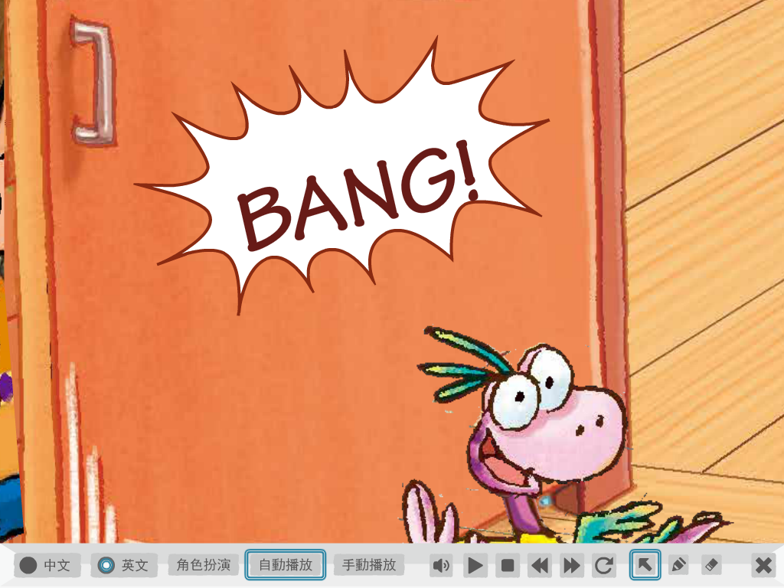
砰!!

Slide 23
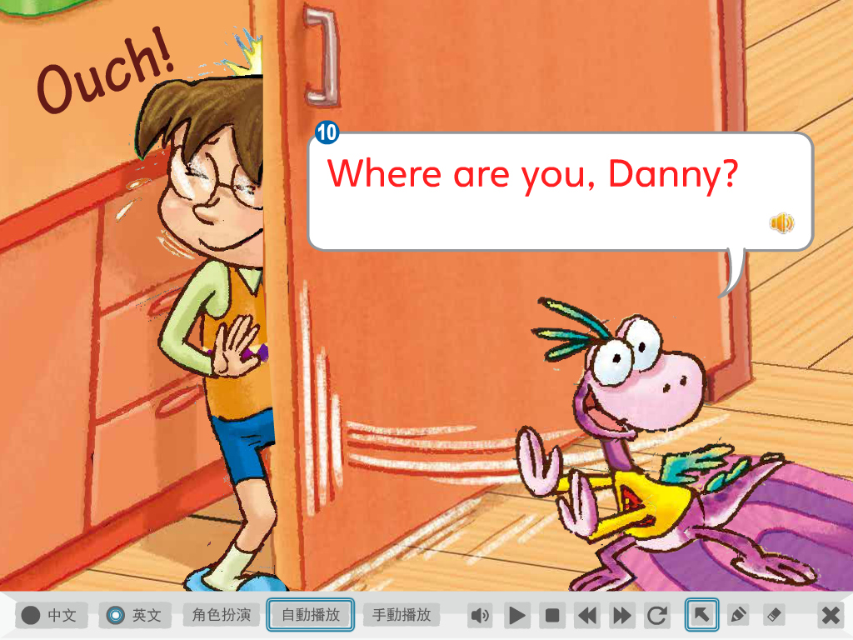

Slide 24
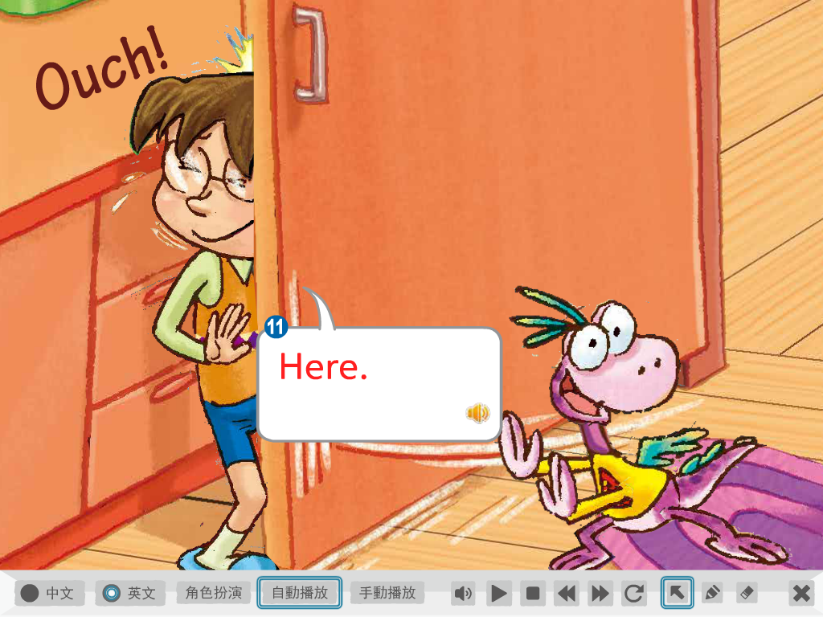

Slide 25
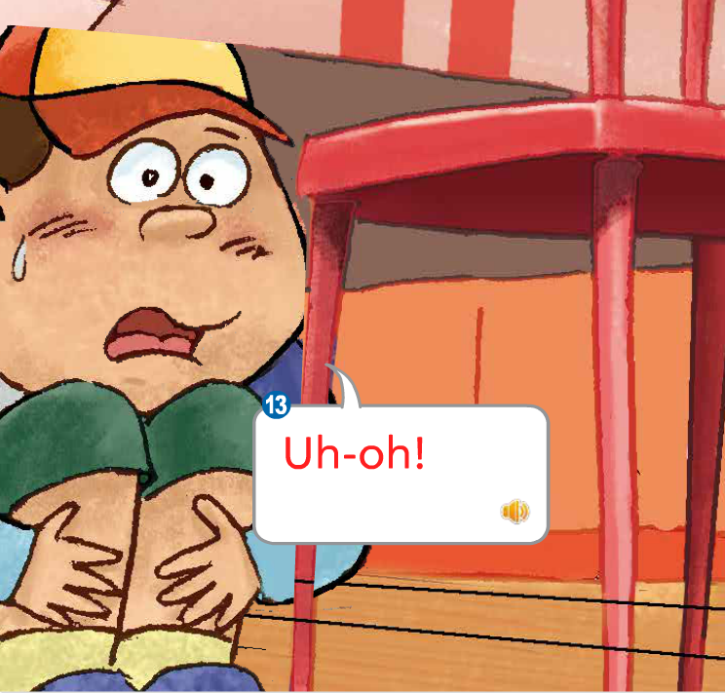
哎呦!

Slide 26
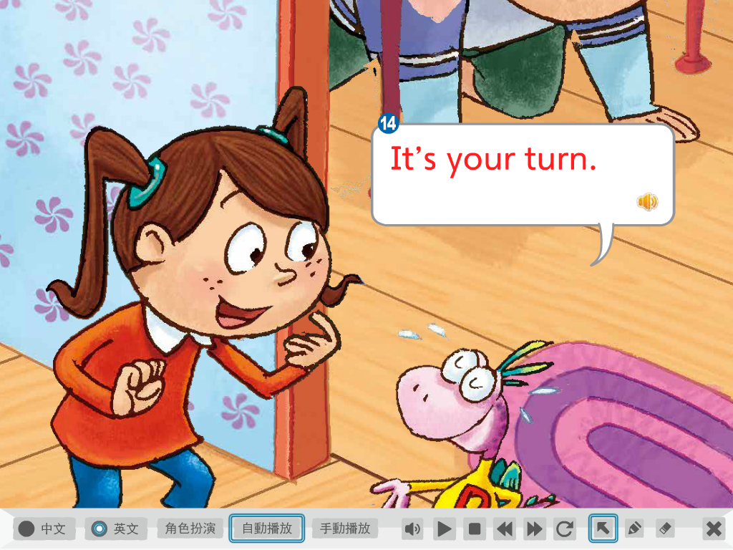
輪到你當鬼了

Slide 27
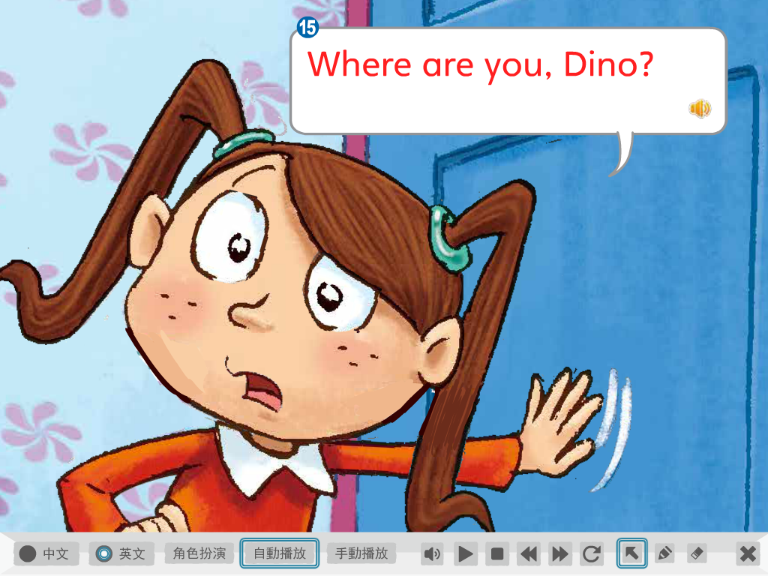

Slide 28
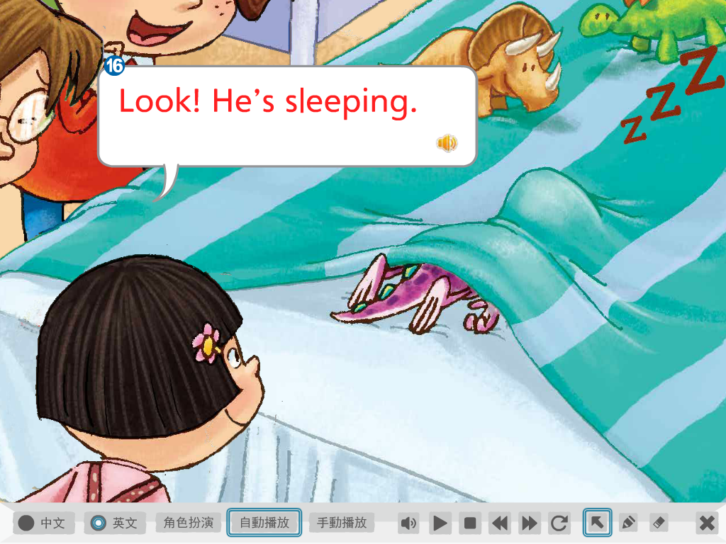
Snore打呼

Slide 29
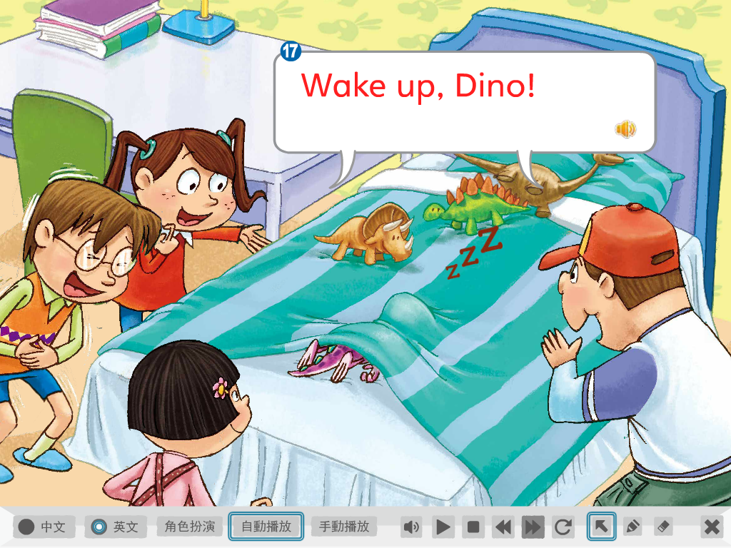

Slide 30
Repeat after CD

Slide 31
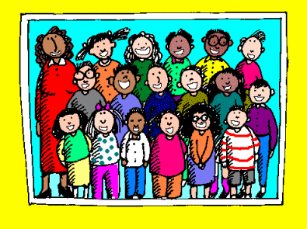
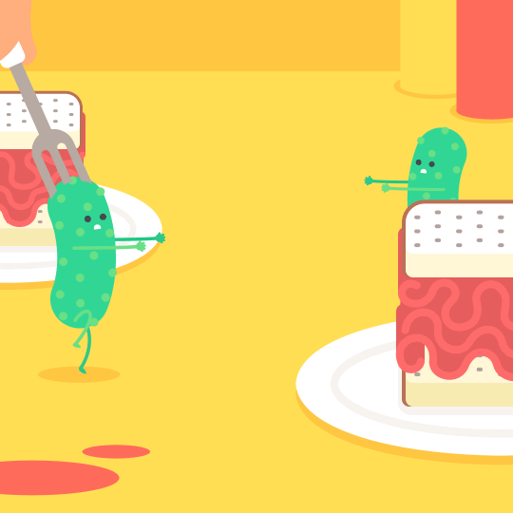
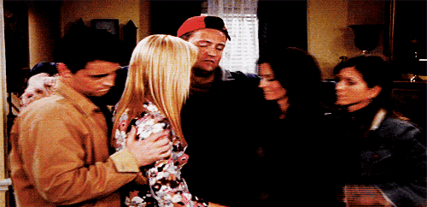
Practice Time
Each group
Personal
Whole class

Slide 32
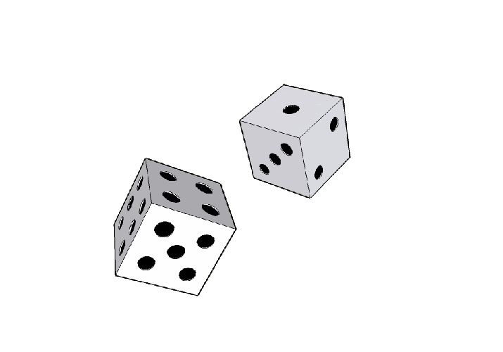
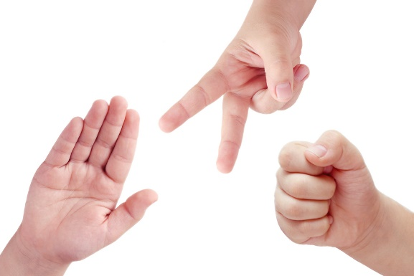
1 → Echo (last words for 3 times)
2 → Group 2/4 read
3 → Group 1/3/5 read
4 → Teacher reads (Find mistake)
5 → Get 20 dollars
6 →

Slide 35
自己先填完
問6位不同的同學

